Slide 1
FIELD VISIT BUISNESS FOR INTERVIEWING ABOUT DIGITAL MARKETING
L.Vishnu Priyan
S.Vishnupriyan
K.Vishwanath
M.Yogarajan

Slide 2
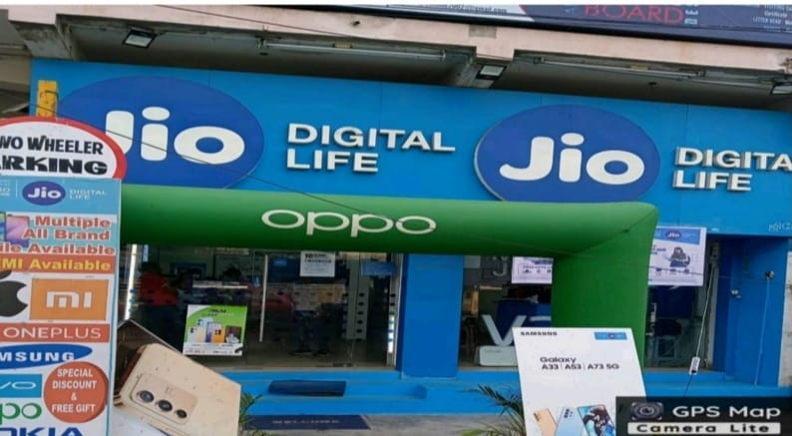
DIGITAL MARKETING IN JIO STORE
Jio is one of the largest telecommunications companies in India,
with over 400 million subscribers. It is a leader in the digital marketing space, offering a variety of solutions to businesses of all sizes.

Slide 3
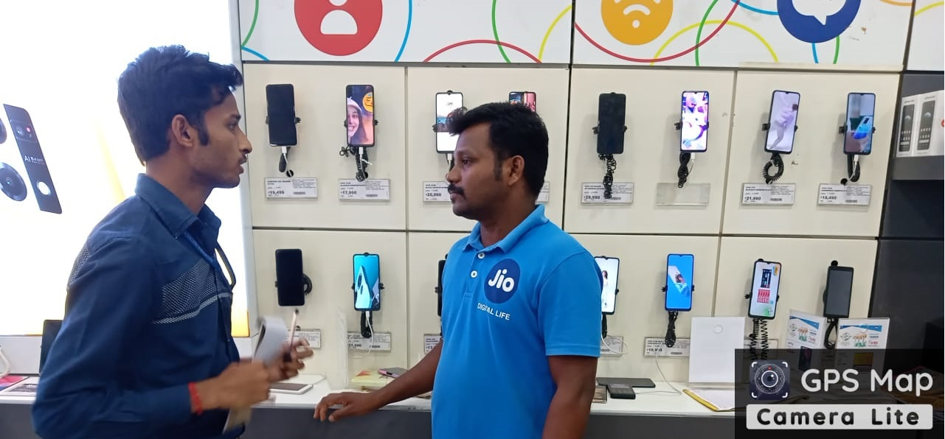
1.What are the main areas for improvement?
I can generate creative text formats, but I can still be more creative in my responses. I need to learn to think outside the box and come up with new and innovative ideas.

Slide 4
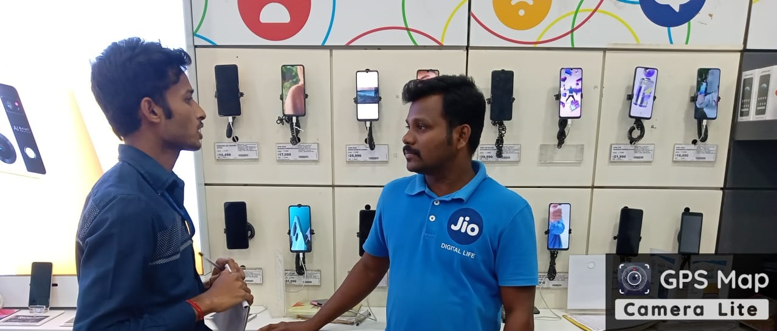
2. What are the main challenges and opportunities facing
this industry?
The digital marketing landscape is becoming increasingly competitive, with more and more businesses vying for attention online. This can make it difficult for businesses to stand out and reach their target audience.

Slide 5
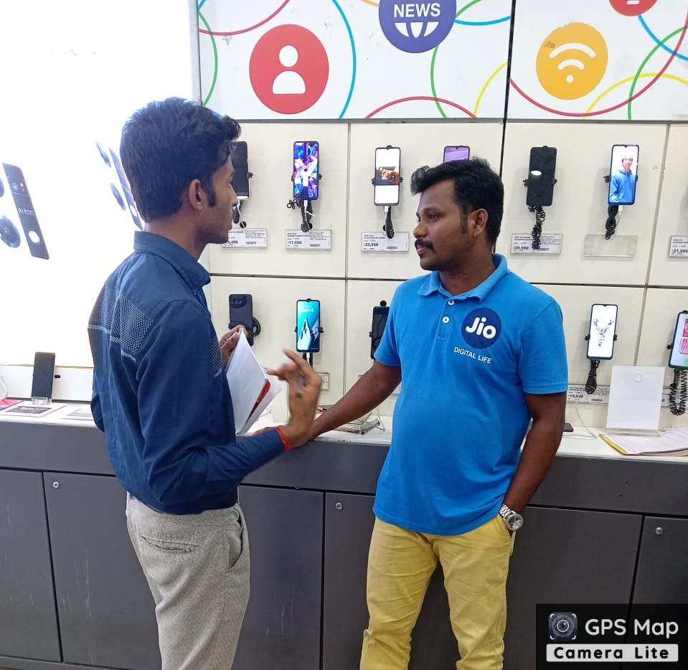
3.What are the main areas for improvement?
Businesses need to be more transparent about how they collect and use customer data. They also need to give customers more control over their data

Slide 6
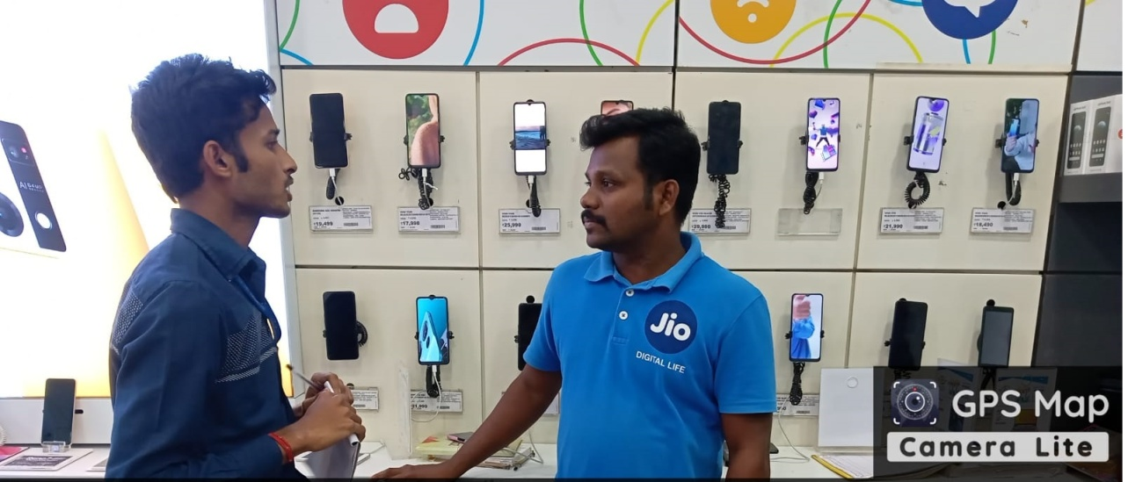
4. How is this industry working towards a more
sustainable future?
Digital marketing companies can support sustainable initiatives by donating to environmental charities or sponsoring sustainable events.
Data centers consume a lot of energy, so digital marketing companies are working to reduce their energy consumption by using more efficient servers and renewable energy sources.

